Slide 1


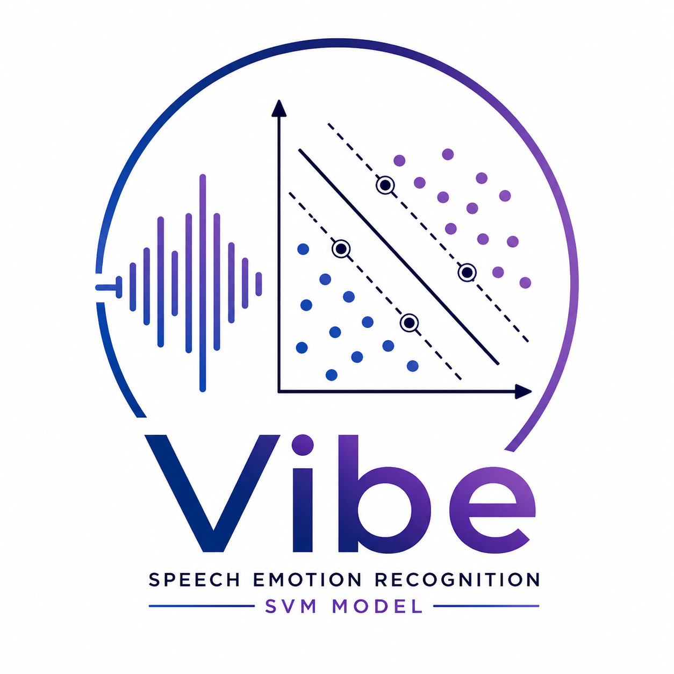
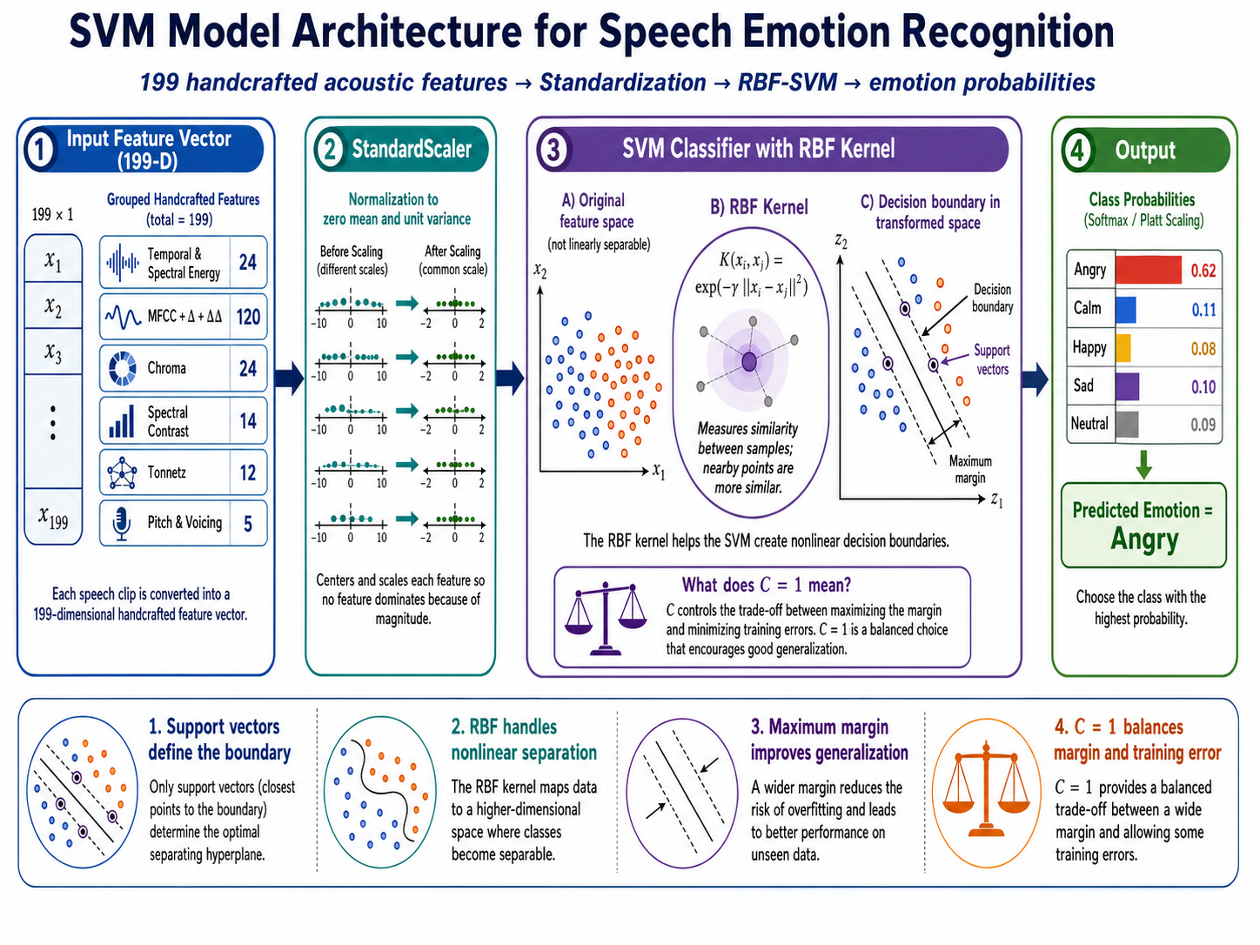
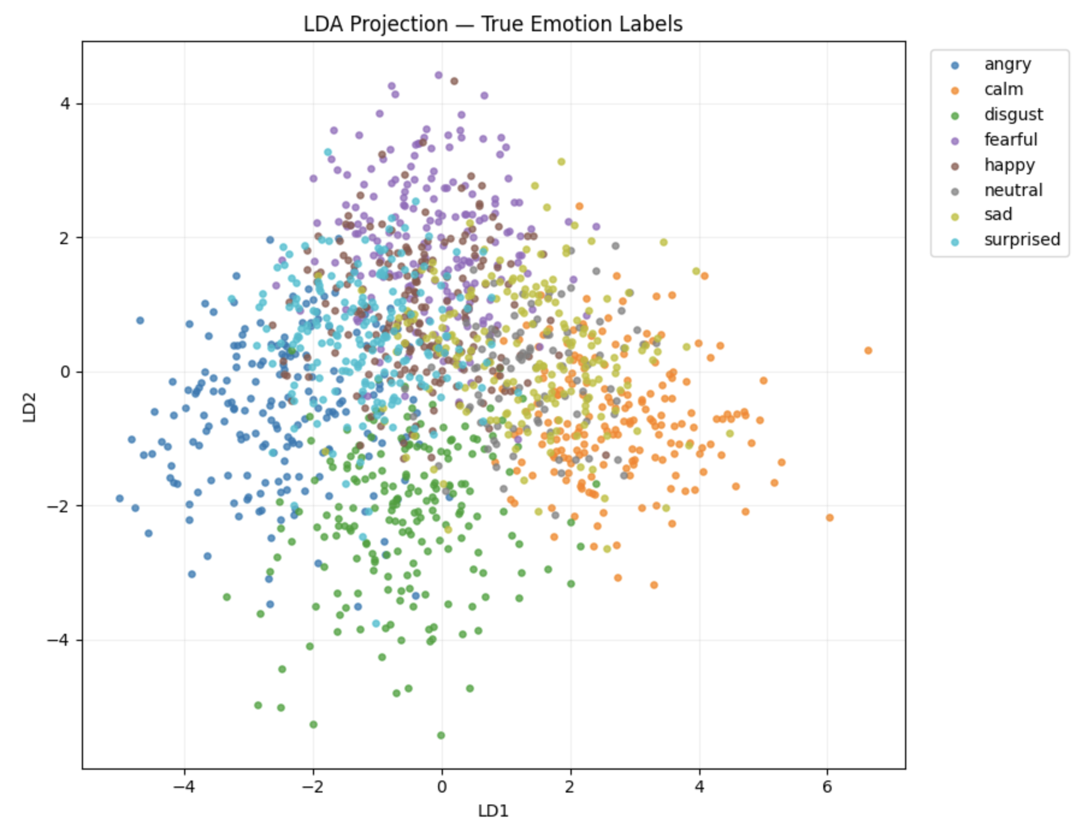
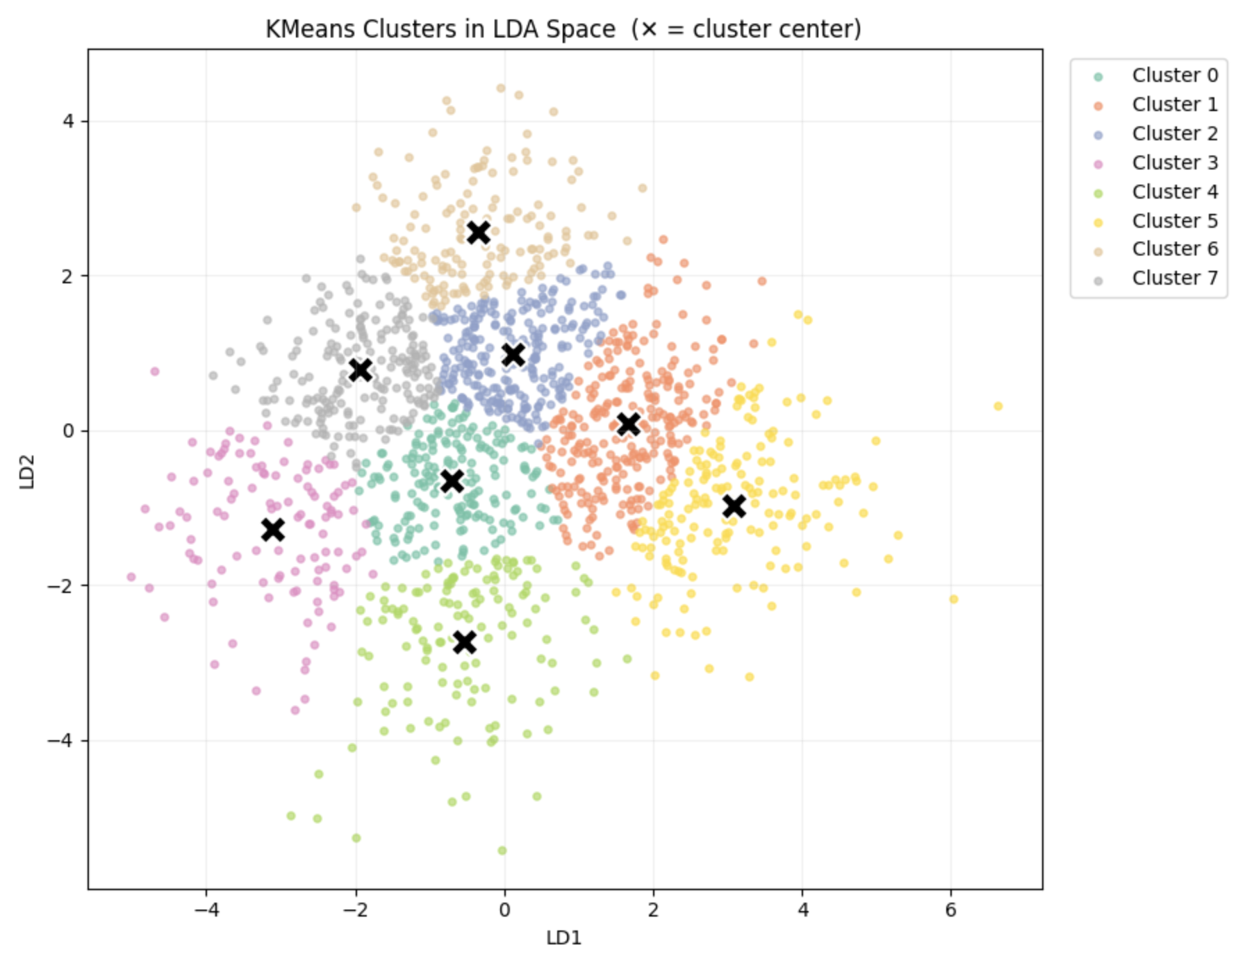
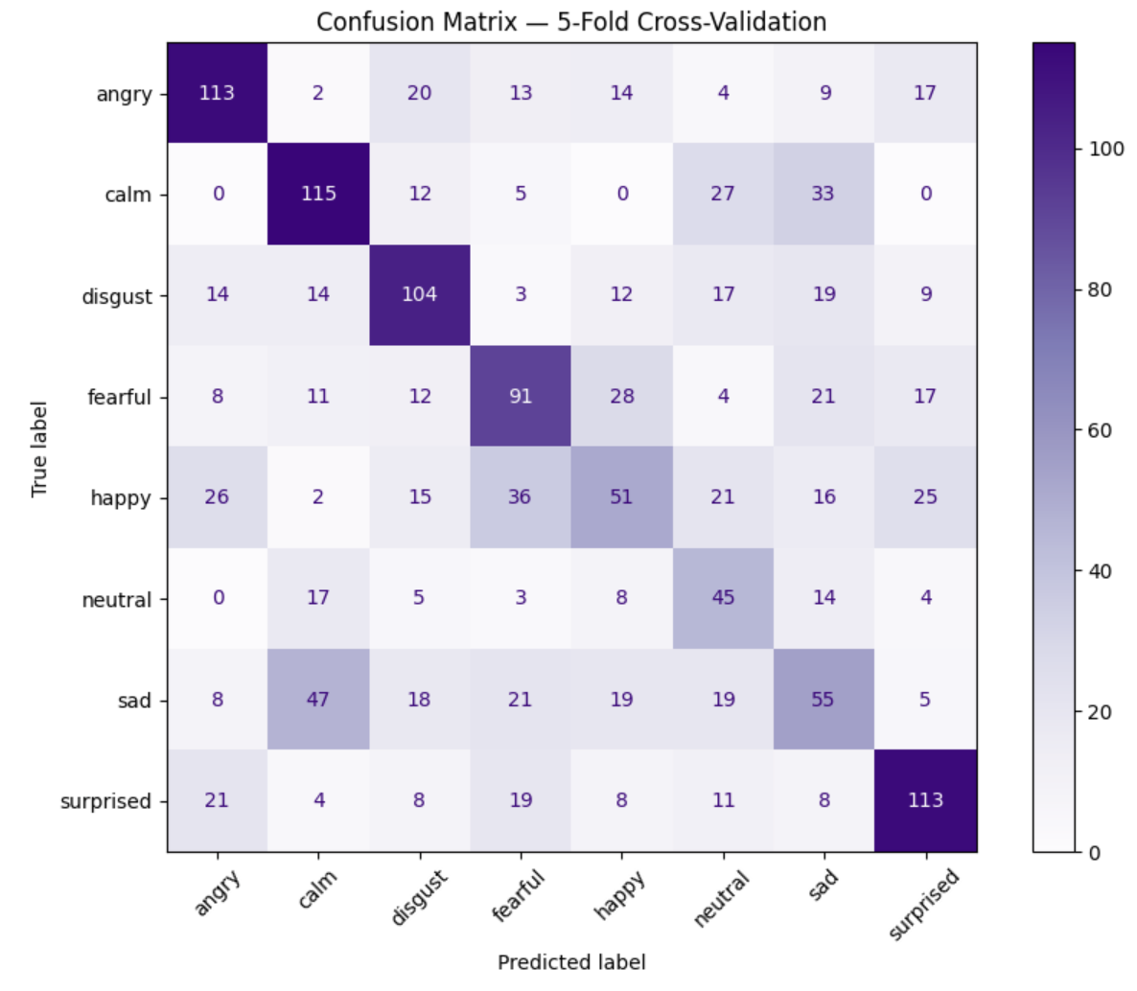
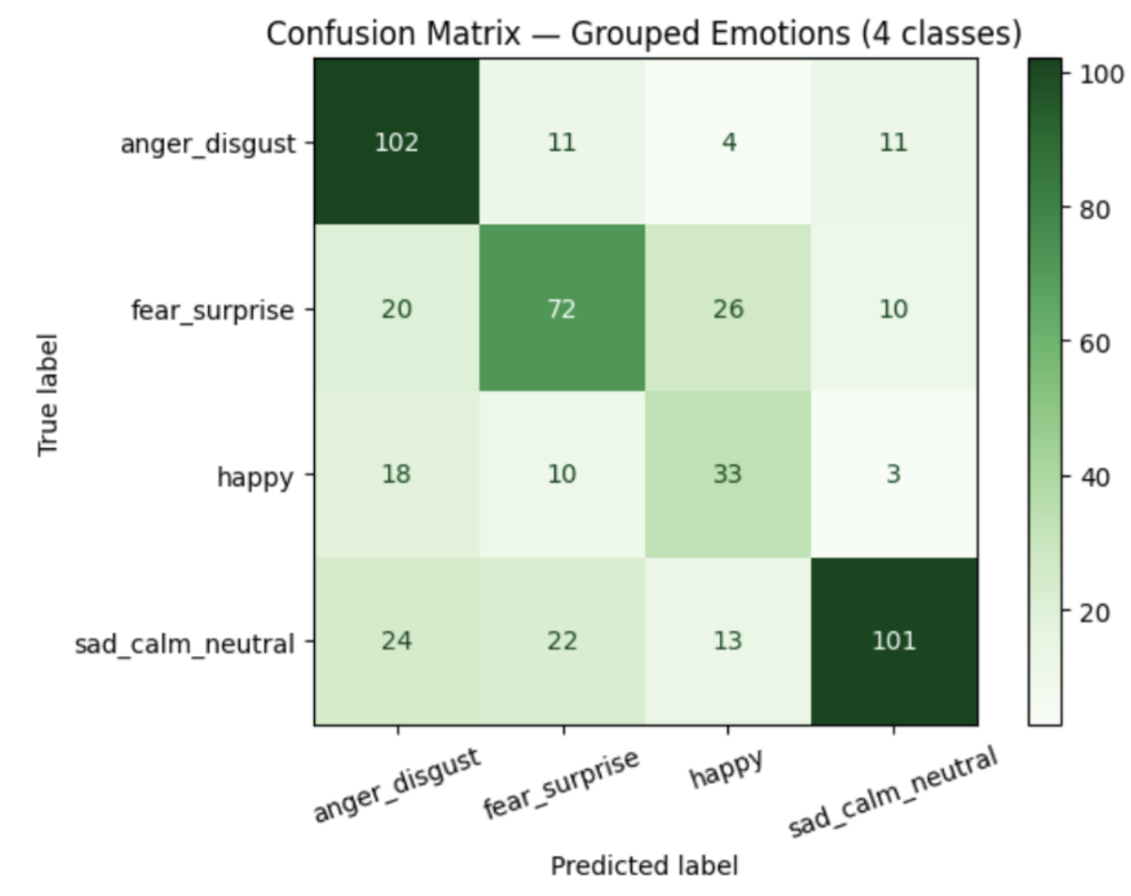
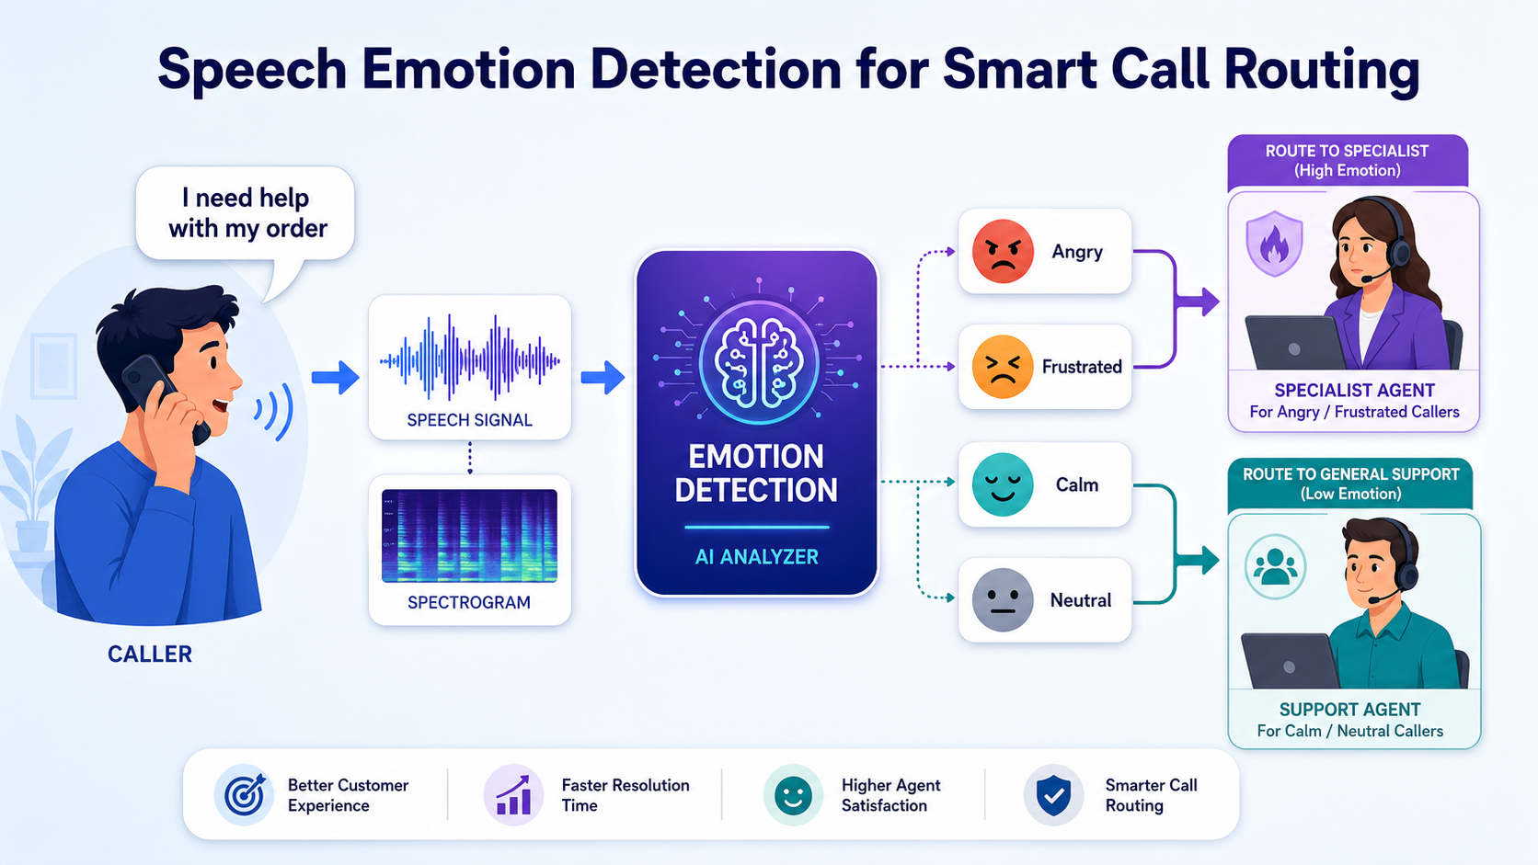
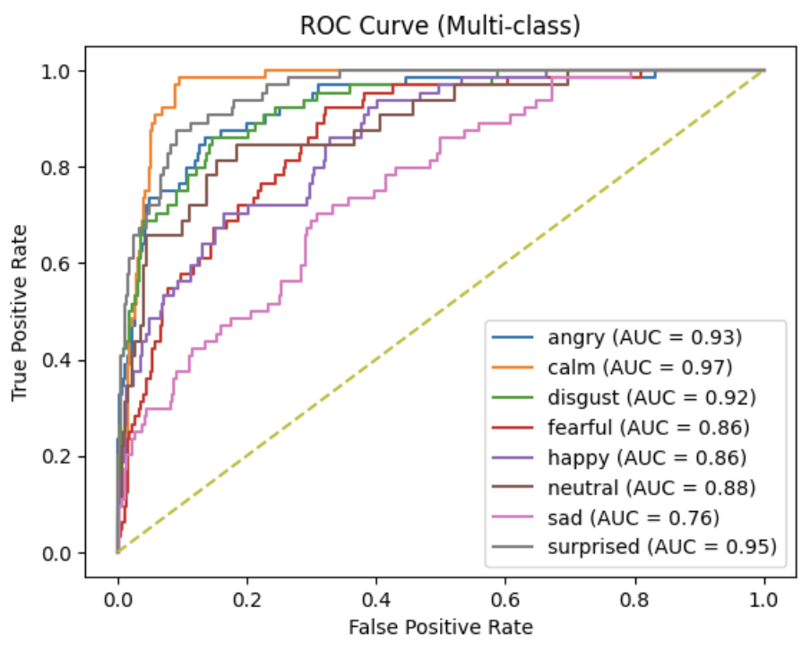
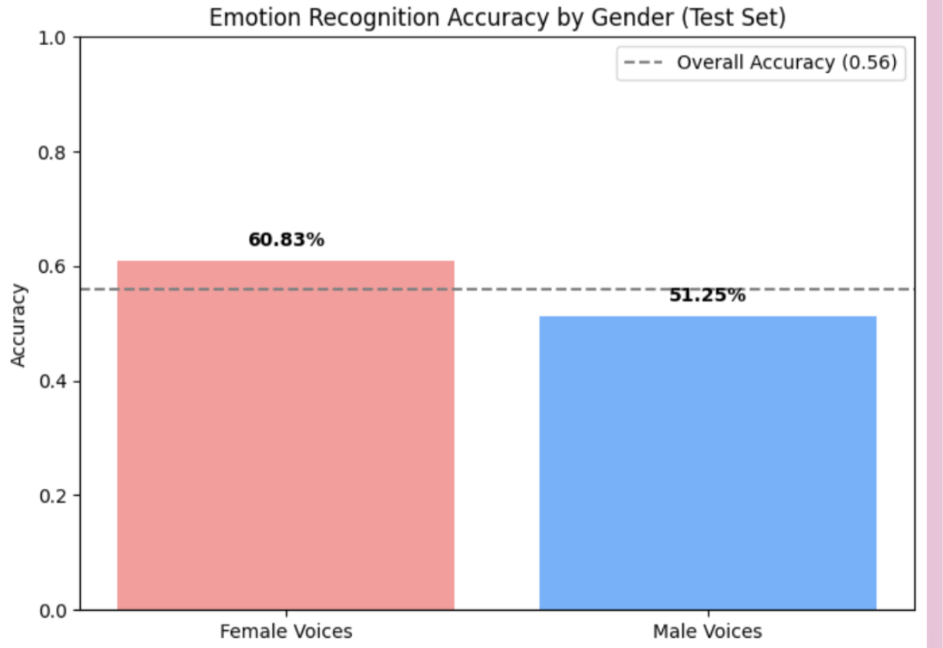
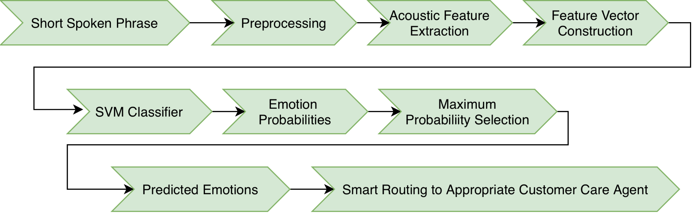
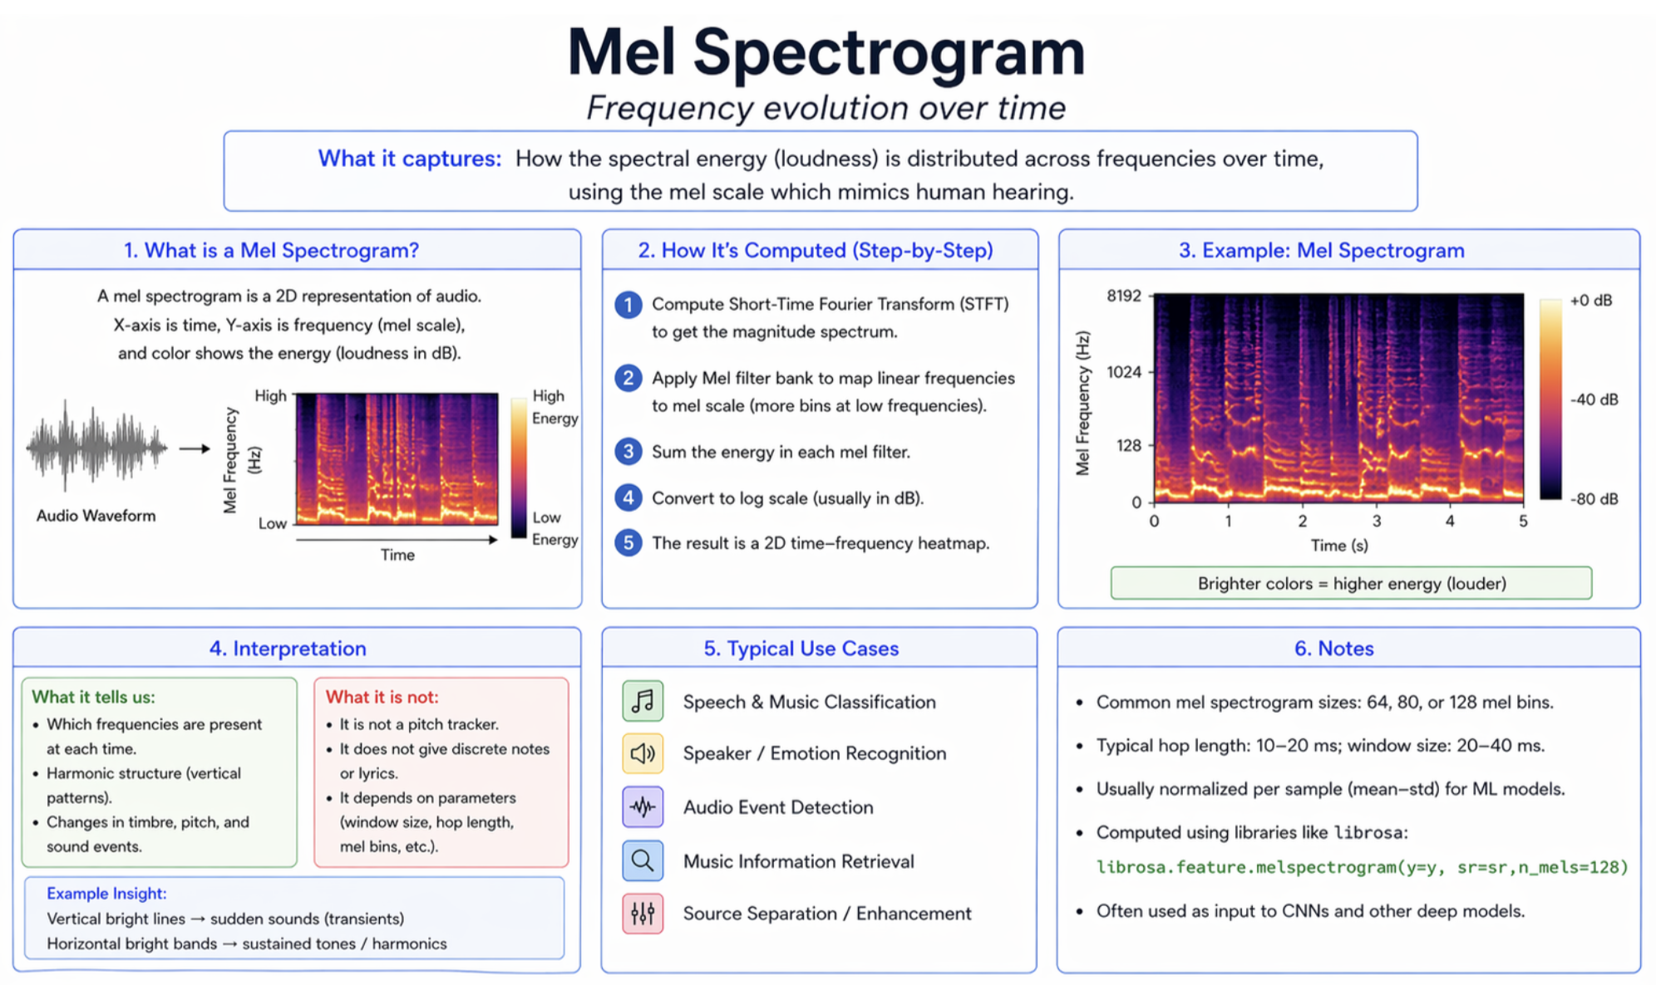
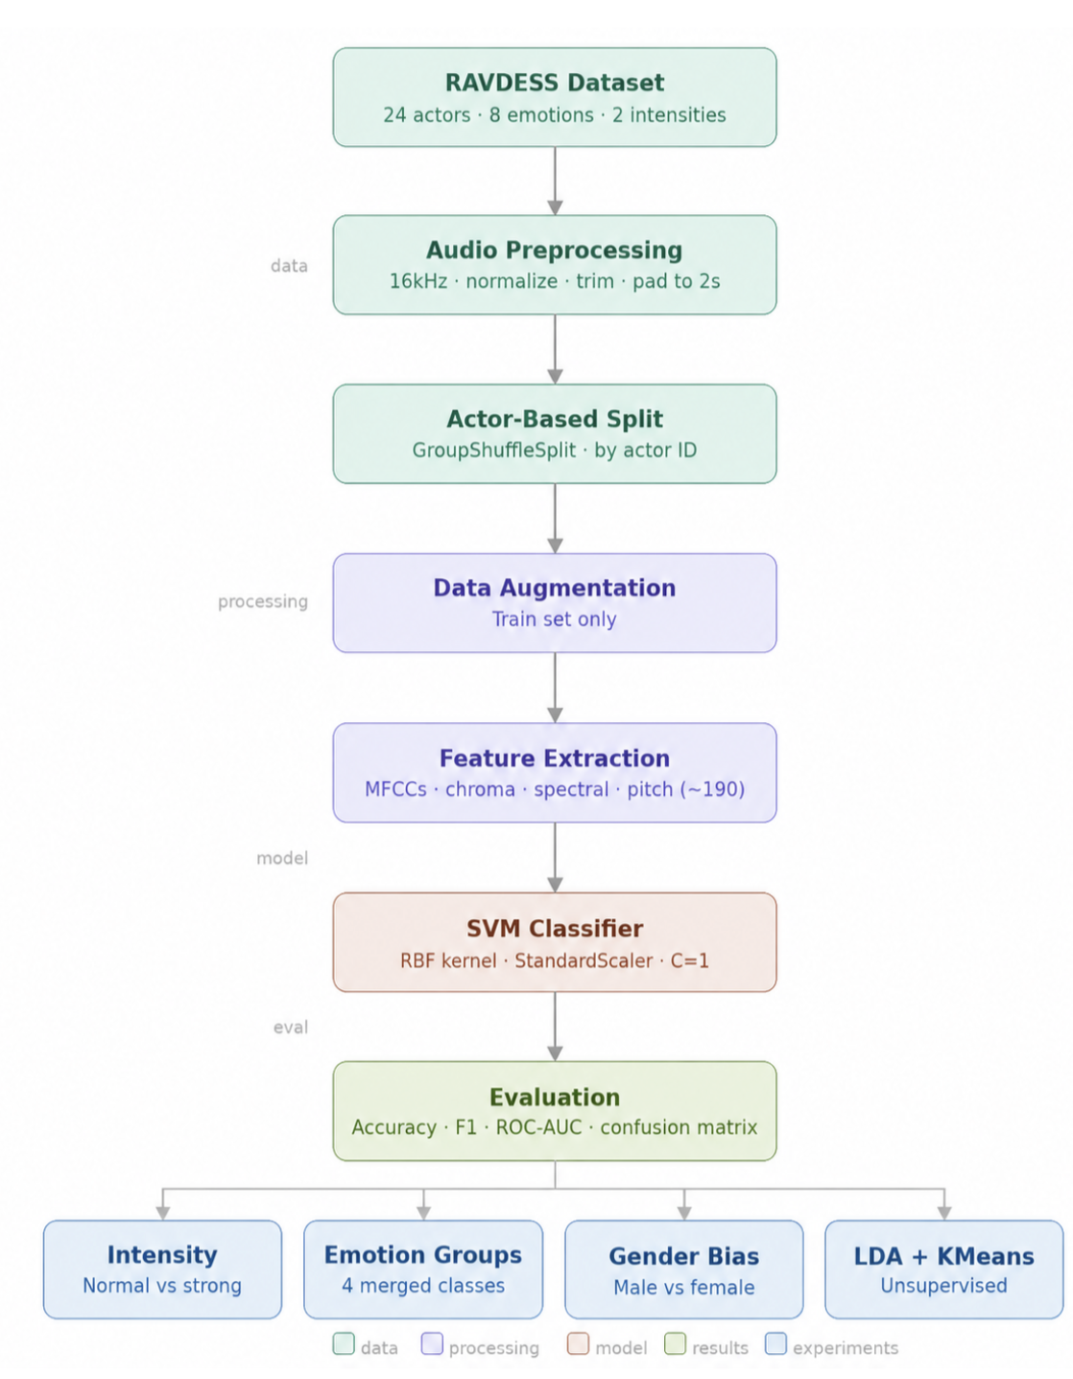
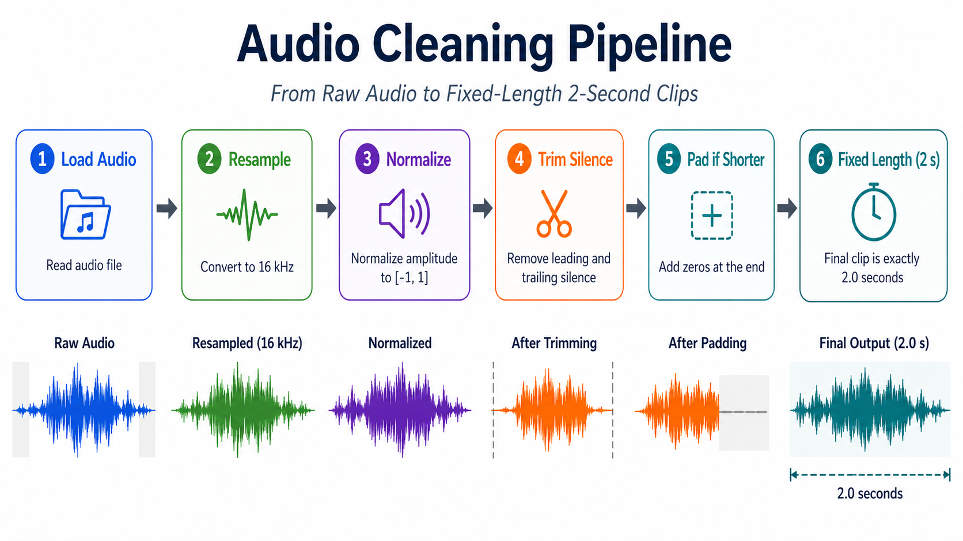
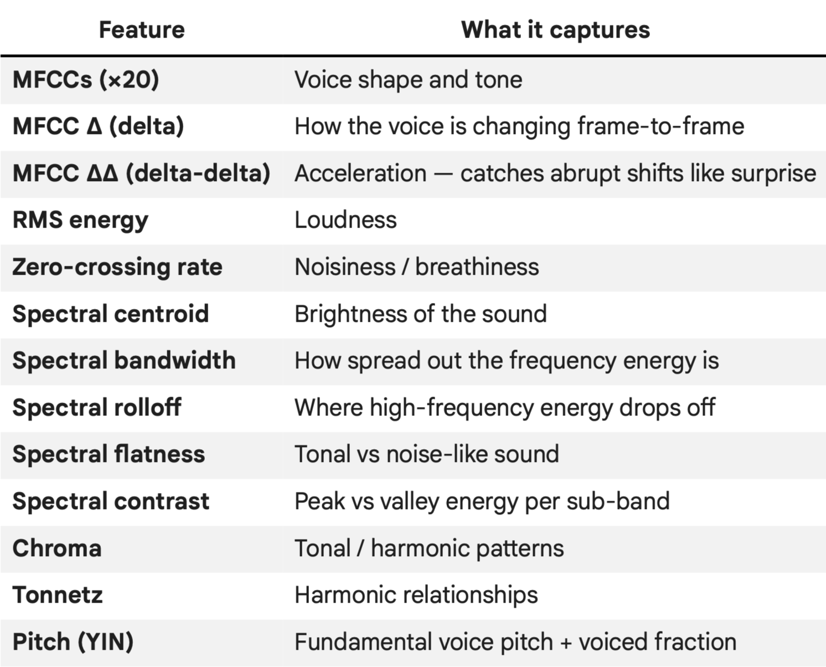
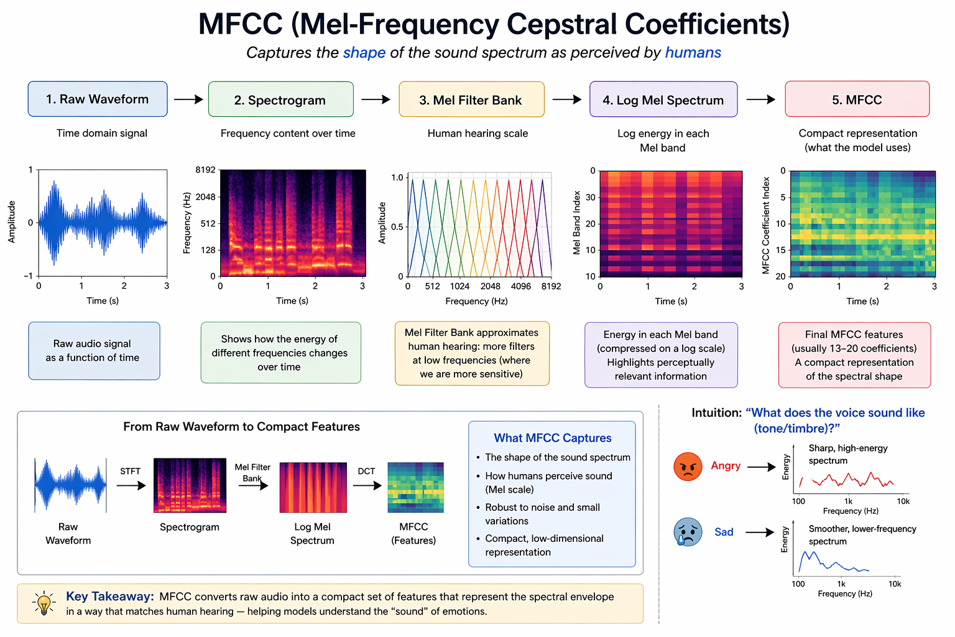
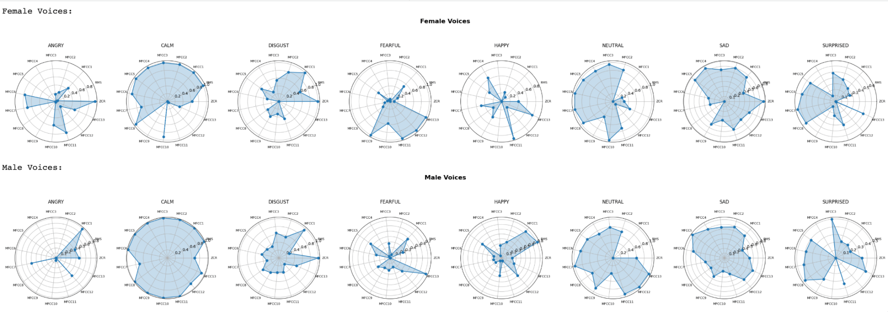
Vibe - Acoustic Feature Based Speech Emotion Recognition
Tina Nguyen, Diego Brown, Jainil Anilkumar Patel, Joshalynn Worth
University of Missouri-Kansas City, Computer Science
Introduction
Methodology
Results
Human emotions are often reflected not only in what people say, but also in how they say it. Tone of voice, loudness, pitch, rhythm, and speech energy can provide important clues about a speaker’s emotional state. This project focuses on classifying emotions from short spoken sentences using acoustic features extracted from audio signals. Instead of using complex deep learning or multimodal video systems, the goal is to build a simple and interpretable speech-based emotion recognition pipeline. The system extracts features such as zero-crossing rate, RMS energy, spectral centroid, spectral bandwidth, spectral rolloff, spectral flatness, MFCCs, log-Mel spectrogram statistics, chroma features, pitch, and voicing information. These features capture different aspects of speech, including vocal energy, frequency distribution, pitch behavior, and speaking style.
A practical application of this system is in customer service or call-center environments. When a customer calls a company and interacts with an automated bot or answers short questions while waiting, the system can analyze the customer’s voice and estimate their emotional state. Based on the detected emotion, the call can be routed to a suitable representative; for example, an angry or frustrated customer can be directed to an agent trained to handle difficult conversations, while a calm or neutral customer can be sent to a general support agent. In this project, a Support Vector Machine classifier is used to predict emotions from the extracted acoustic feature vectors. The broader goal is to show that traditional machine learning with carefully selected speech features can provide a practical solution for emotion detection from short audio phrases.
Application Overview
Future Scope
Data Processing.
Proper Sampling, Normalization, Trimming, and padding to make all the audios to the same size.
The file name is checked and parsed to get the ground truth labels.
Feature Engineering
Generated around 200 features which can be used to classify the sounds
1) Multi pipeline model - Turning the sounds to text and predicting the sentiments based on NLP
2) Boosting model - Keep getting the predictions of 2 second windows, and aggregating them before giving the final output.
3) Real time prediction of the emotions.
4) Further study performance differences across gender, accent, age group, or speaker identity to make the system more reliable and fair
Cleaning Pipeline
References
Livingstone, S. R., & Russo, F. A. (2018). The Ryerson Audio-Visual Database of Emotional Speech and Song (RAVDESS): A dynamic, multimodal set of facial and vocal expressions in North American English. PLOS ONE, 13(5), e0196391.
Livingstone, S. R., & Russo, F. A. (2018). The Ryerson Audio-Visual Database of Emotional Speech and Song (RAVDESS): A dynamic, multimodal set of facial and vocal expressions in North American English. PLOS ONE, 13(5), e0196391.
Schuller, B., Rigoll, G., & Lang, M. (2004). Speech emotion recognition combining acoustic features and linguistic information in a hybrid support vector machine-belief network architecture. ICASSP, I-577–I-580.
Normalization: Scales all audio clips to a consistent amplitude range, reducing the effect of speaker loudness and recording volume. This helps the model focus on emotion-related voice patterns.
2 Second Fixed Length: We tested full-length audio, but short phrases were enough for emotion prediction. Limiting clips to 2 seconds made feature extraction faster and kept all samples consistent. Short clips were padded at the end.
Pipeline of the project
Acknowledgments
University of Missouri - Kansas City
CS5530: Principles of Data Science
Professor: Syed Jawaad Hussaian Shah

